Slide 1
SQL Project
Ali Faisal Raza
16-Jan-2023

Slide 2
Agenda
Data Review
Data Cleaning
Existing Questions
Connections to Explore
Alternative Database Design

Slide 3
Data Review
There are a total of 5 tables including 1 product master table, 2 sales tables and 2 analytics tables.
‘sales_report’ is a derivative table and can be generated from ‘products’ and ‘sales_by_sku’ tables. So, it is a redundant table.
The data in ‘analytics’ and ‘sessions’ tables have similar named columns, but the data is not exactly same.
‘Analytics’ table is comparatively much bigger with information on user page views, time spent on site, revenue generated etc. ’Sessions’ table contains similar titled information at lower magnitude of scale and also contains product related information.
“Products” table contains product information for each product. Many products are however missing from this table and referenced in other tables.

Slide 4
Data Cleaning
Copy of tables were made to perform data cleaning.
Redundant columns with no value in ”analytics” and “sessions” tables were dropped.
Currency was standardized to USD for all transactions based on overwhelming transactions being performed in USD already.
All numeric columns with null value were populated with 0 where it didn’t interfere with business logic.
Prices and revenues were divided by million for ease of data handling and interpretation.

Slide 5
Existing Questions
**Question 1: Which cities and countries have the highest level of transaction revenues on the site?**
**Question 2: What is the average number of products ordered from visitors in each city and country?**
**Question 3: Is there any pattern in the types (product categories) of products ordered from visitors in each city and country?**
**Question 4: What is the top-selling product from each city/country? Can we find any pattern worthy of noting in the products sold?**
**Question 5: Can we summarize the impact of revenue generated from each city/country?**
Observations:
The products sales data is very limited. There is limit to usefulness of this data for insights owing to low sale numbers.
Based on limited information, it appears that US is the primary market for the company products.

Slide 6
Connections to Explore
Visitors who generated maximum revenue for the company and their visit behavioral patterns on the site?
Social channels capable of generating maximum revenue including relevance, if any, of social media engagement of visitors for company revenue?
Company's revenue pattern over year and month time scale?
Correlating of page views and time spent on site to the prospect of revenue generation for each product category?

Slide 7
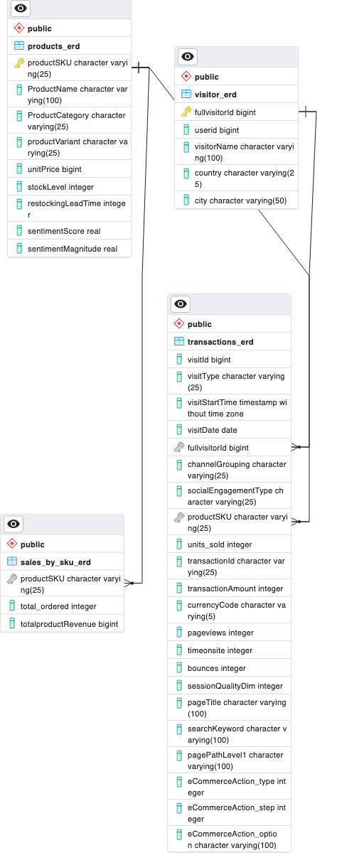
Alternative Database Design

Slide 8
Questions..

